Slide 1
CASE Tools and Advance Practices of System Dependability and Security
Dr. Neeraj Sahu Associate Professor
CSE-AIML

Slide 2
CONTENT
Computer Aided Software Engineering Tools………3
SCRUM Developments……………………………..…6
Dependable System………………………………….10
Reliability Engineering………………………………..12
Safety Engineering……………………………………14
Security Engineering………………………………….17
Resilience Engineering……………………………....19

Slide 3
Introduction
Definition
CASE Tools are software applications used to automate, manage, and simplify various phases of the Software Development Life Cycle (SDLC).
Purpose: To improve software quality, increase development speed (productivity), reduce costs, and ensure consistency across the project.
COMPUTER AIDED SOFTWARE ENGINEERING TOOLS

Slide 4
Components of CASE Tools
Central Repository (Data Dictionary): A central database storing all project information, diagrams, reports, and documentation to ensure consistency.
Upper CASE Tools (Front-end): Focus on early SDLC phases: Planning, Requirements Analysis, and Design (e.g., modeling tools).
Lower CASE Tools (Back-end): Focus on later SDLC phases: Implementation, Testing, and Maintenance (e.g., code generators, debuggers).
Integrated CASE (I-CASE): Tools that support the entire SDLC, combining upper and lower functionalities.

Slide 5
Types of CASE Tools
Diagramming Tools: Create visual models (Flowcharts, Entity-Relationship Diagrams, Data Flow Diagrams).
UML Modeling Tools: Used for object-oriented analysis and design (e.g., Rational Rose).
Code Generators: Automatically generate source code from design models.
Testing Tools: Automate testing (e.g., Selenium for web applications, JUnit).
Documentation Tools: Generate technical documentation and user manuals.
Version Control/Configuration Management Tools: Track changes to code (e.g., Git, SVN).

Slide 6
SCRUM Developments
Scrum is an Agile framework for developing, delivering, and sustaining complex products through collaboration, accountability, and iterative progress. It uses fixed-length iterations called "Sprints" (usually 2-4 weeks) to deliver incremental, high-value product updates, allowing teams to adapt quickly to changing requirements.

Slide 7
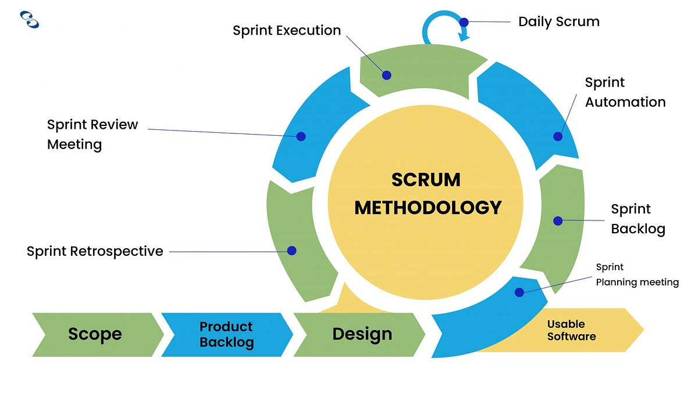
SCRUM Developments

Slide 8
SCRUM Developments
Key Components of Scrum Development:
Roles: The Scrum Team consists of the Product Owner (defines requirements/priorities), Scrum Master (facilitates process/removes impediments), and Development Team (cross-functional, self-organizing members who build the product).
Artifacts:
Product Backlog: An ordered list of everything needed in the product.

Slide 9
SCRUM Developments
Sprint Backlog: The set of items selected for the current Sprint.
Increment: The usable, "Done" product functionality produced at the end of a Sprint.
Events (Ceremonies):
Sprint Planning: Defines what will be delivered.
Daily Scrum (Stand-up): 15-minute daily meeting to synchronize activities.
Sprint Review: Demo of the increment to stakeholders for feedback.
Sprint Retrospective: Team reflection to improve processes for the next sprint

Slide 10
Dependable System
What is System Dependability?
Dependability refers to the trustworthiness of a computer system, ensuring that it delivers services reliably and securely. It includes:
Availability: Ready for service when requested.
Reliability: Service is delivered as specified.
Safety: System does not cause damage in case of failure.
Security: Protection against accidental or deliberate intrusion.

Slide 11
Advanced Practices for Dependability
Redundancy: Implementing multiple components to perform the same task to avoid single points of failure.
Process-Oriented Approaches: Using formal methods, rigorous testing, and structured development life cycles (e.g., Agile with continuous integration).
Fault Tolerance: Designing systems to continue operating even when components fail (e.g., recovery blocks, N-version programming).
Defensive Programming: Writing code that anticipates errors, checks input validity, and handles exceptions.
Re-engineering: Updating legacy systems to improve dependability without changing functionality.

Slide 12
Reliability engineering
Reliability engineering is a sub-discipline of systems engineering focused on ensuring products, systems, or processes perform intended functions without failure over a specified time. It utilizes techniques like Failure Modes and Effects Analysis (FMEA), fault tree analysis, and physics of failure to predict, mitigate, and manage risks and failure, optimizing asset life cycles and reducing costs.
Key aspects of reliability engineering include:
Core Pillars: Reliability (probability of failure-free operation), Availability (uptime percentage), and Maintainability (ease of repair).

Slide 13
Reliability engineering
Key Techniques: Root Cause Analysis (RCA), Reliability Modeling, and Accelerated Life Testing (ALT).
Objectives: Enhance safety, increase product life, minimize maintenance costs, and maximize customer satisfaction.
Applications: Essential in industries like manufacturing, aerospace, nuclear, and software (Site Reliability Engineering - SRE).

Slide 14
Safety engineering
Safety engineering is a specialized discipline focused on preventing accidents, injuries, and system failures by identifying hazards and designing, implementing, and auditing safety systems. It ensures that industrial, chemical, and mechanical systems operate within safe limits, combining engineering principles with risk analysis to protect people and assets.
Key Aspects of Safety Engineering
Prevention Through Design: Safety engineers design safer equipment,, implement machine guards, and optimize, workflow to eliminate hazards at the source rather than relying solely on personal protective equipment.

Slide 15
Safety engineering
Risk Management: They conduct hazard, analysis (e.g., for fire, explosion, chemical exposure) and evaluate the severity of potential incidents.
Compliance and Regulation: Safety engineers ensure, workplaces adhere to local and international safety standards and regulations.
Audit and Inspection: They perform regular inspections to ensure machinery is properly maintained and safety procedures are followed.
Root Cause Analysis: When incidents occur, safety engineers analyze, the causes to prevent recurrence.

Slide 16
Safety engineering
Core Components
System Safety Engineering: Ensures that, complex, high-risk, systems (like, aerospace or, chemical plants) behave safely even if components fail.
Process Safety Management: Focuses on preventing, releases of, hazardous, materials or energy.
Human Factors Engineering: Accounts for human behavior and, limitations in system design to reduce errors

Slide 17
Security Engineering
Security engineering is an interdisciplinary, proactive field focused on designing, implementing, and maintaining secure, resilient information systems to prevent unauthorized access and malicious behavior. It involves integrating security controls early in the development lifecycle to manage risk, utilizing tools like firewalls, SIEM, and cryptography.
Key aspects of security engineering include:
Proactive Security: Instead of just responding to incidents, security engineers anticipate, identify, and mitigate risks, often using techniques like penetration testing.

Slide 18
Security Engineering
Core Functions: Responsibilities include designing secure network architectures, implementing encryption, managing access controls, and developing automated tools for security monitoring.
Skill Set: Strong foundations in coding (Python, C++), networking, cryptography, and operating system security are crucial.
Key Principles: Security engineers rely on principles like defense in depth (layered security) and the principle of least privilege.
Interdisciplinary Scope: The field integrates knowledge from computer science with psychology, sociology, economics, and physics to build dependable systems.

Slide 19
Resilience engineering
Resilience engineering is a safety and operational discipline focused on building systems that can anticipate, absorb, adapt to, and recover from unexpected disruptions or failures. Unlike traditional safety methods that focus on preventing specific hazards (Safety-I), it emphasizes the ability to sustain operations under changing conditions and learn from both successes and failures.
Key Aspects of Resilience Engineering:
Proactive Management: It shifts from reacting to incidents to actively identifying potential failure modes before they cause damage.

Slide 20
Resilience engineering
Complex Adaptive Systems: It treats systems (e.g., IT, healthcare, aviation) holistically, acknowledging that, in modern, interconnected systems, failures are inevitable, necessitating systems that can adapt.
Safety-II Approach: It operates on the principle that to ensure safety, systems must be able to function under varying, often unpredictable conditions, rather than just eliminating failures.
Application Areas: It is used to build robust software (e.g., handling immense transaction loads), in cybersecurity, and in critical infrastructure like power plants and hospitals to maintain service continuity.

Slide 21
Resilience engineering
Components of a Resilient System:
Robustness: The ability to withstand disturbances.
Adaptability: The capability to change or adjust to new conditions.
Recoverability: The capacity to return to a stable state after a disruption.
Resilience engineering ensures systems are not just safe, but also flexible and efficient in unpredictable environments.

